Slide 1
Unit 4
Ionic Bonds and Nomenclature

Slide 2
Week 24 February 24-February 28

Slide 3
Thursday
Students will be able to draw Lewis Dot Structures in order to visualize and draw the transfer or electrons.
February 27

Slide 4
Do Now 2/27/14 (2nd/3rd/7th)
Explain why noble gases are unreactive (not reactive)

Slide 5
Do Now 2/27/14 (2nd/3rd/7th)
Noble gases have a full/filled valence shell (outer shell)
Based on the octet rule, atoms want to gain/lose electrons in order to have 8 electrons in the valence shell.

Slide 6
QUIZ TOPICS REVIEW
Ions
    Cations
    Anions
    Noble gases
    Protons
    Electrons
Ionic charge/oxidation number
Counting Atoms
Monoatomic ions
    Writing chemical formulas
    Naming compounds
Polyatomic ions
    Writing chemical formulas
    Naming compounds

Slide 7
HOMEWORK
Turn in your homework sheet “Writing Formulas Sheet #1”
        Both sides should be completed

Slide 8
What You Need
Something to write with
Periodic table
Lined paper (some in the front of the room)
Ions & Ionic Compounds HW Packet
Any notes from class

Slide 9
Pick 1 Partner
You have 1 minute to pick a partner
      Bring materials with you
THEN, wait for directions

Slide 10
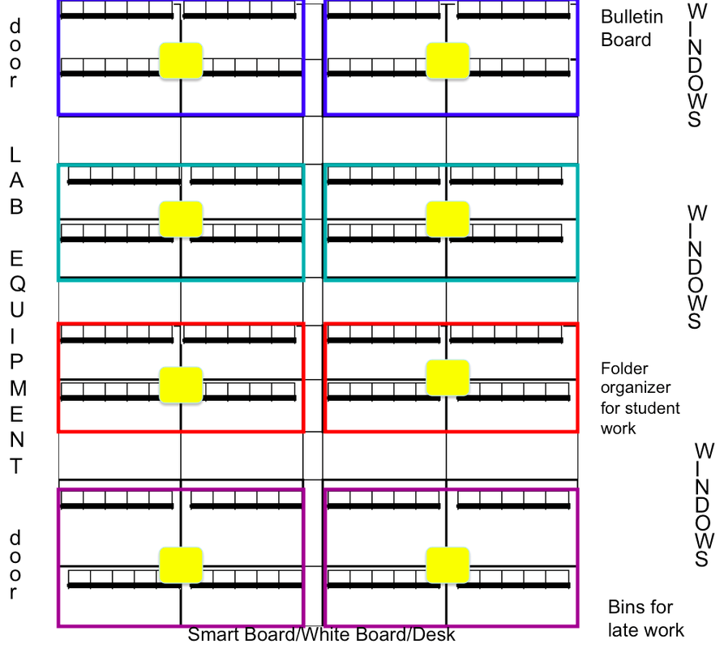
Find a spot with your partner
PARTNERS
PARTNERS
PARTNERS
PARTNERS
You should be on the SAME side as your partner
PARTNERS
PARTNERS
PARTNERS
PARTNERS
PARTNERS
PARTNERS
PARTNERS
PARTNERS
PARTNERS
PARTNERS
PARTNERS
PARTNERS

Slide 11
Ions Stations Review
RULES
      Stations #1-5 need to be complete
      7 minutes at each station
      If you & your partner are finished, get the answer for your station from Ms. Wang

Slide 12
Moving from Station to Station
1
2
3
4
5

Slide 13
Find a spot with your partner
4
5
PARTNERS
PARTNERS
PARTNERS
PARTNERS
You should be on the SAME side as your partner
3
1
PARTNERS
PARTNERS
PARTNERS
PARTNERS
PARTNERS
PARTNERS
2
2
PARTNERS
PARTNERS
PARTNERS
PARTNERS
PARTNERS
3
PARTNERS
1
5
4

Slide 14
At Each Station
Write “Station __”
Write down ALL questions first
See example below
YOUR PAPER
Station 1
Chemical Formula | Name
1. SrCl₂
2. BF₃
3. SF₆
4. (NH₄)₂Cr₂O₇
5. Pb(CO₃)₂ Pb has +4 charge
6. NI₃
Now…write down your answers

Slide 15
GO BACK
Finish questions from ANY station now

Slide 16
Try these
Write names for the following compounds.
    CaCO₃
    Al₂(SO₄)₃
    Ca(ClO₃)₂
    K₃PO₄
    Mg(OH)₂

Slide 17
Answers
Calcium carbonate
Aluminum sulfate
Calcium chlorate
Potassium phosphate
Magnesium hydroxide

Slide 18
Now, these!
Write formulas for the following compounds.
  Lithium sulfate
  Calcium acetate
  Aluminum nitrate
  Magnesium phosphate
  Sodium carbonate

Slide 19
Answers
Li₂SO₄
Ca(C₂H₃O₂)₂
Al(NO₃)₃
Mg₃(PO₄)₂
Na₂CO₃

Slide 20
Friday
Students will be able to identify ions in order to write the names of ionic compounds.
February 28

Slide 21
Do Now 2/28/14 (2nd, 3^{rd,} 7th)

